Slide 1

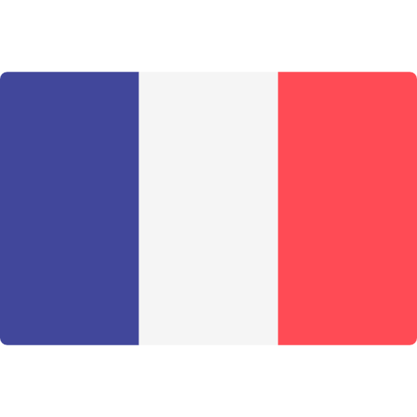



Sports media market in France
Revenue growth in sports broadcasting industry
The sports broadcasting industry in France has seen a steady revenue growth of 5% annually over the past five years, reaching a total market value of €2.5 billion in 2020. Key players such as Canal+ and beIN Sports dominate the market, with a combined viewership of over 12 million subscribers. The popularity of football, rugby, and tennis drives the demand for premium sports content in the country.
Emerging trends in digital sports content
Digital platforms are reshaping the sports media landscape in France, with a shift towards live streaming, on-demand services, and interactive fan experiences. Major broadcasters are investing in exclusive digital rights and partnerships to engage younger audiences and capitalize on changing viewing habits. Social media platforms like Facebook and Twitter have also become key players in sports content distribution and audience engagement.
Impact of major sporting events on media consumption
The hosting of major sporting events such as the FIFA World Cup and the Tour de France significantly boosts media consumption in France, leading to spikes in TV viewership, online streaming, and social media interactions. Advertisers leverage these events to reach a broader audience and enhance brand visibility through targeted sports marketing campaigns. The synergies between sports events, media coverage, and consumer engagement underscore the dynamic nature of the sports media market in France.

